Slide 1

Bay Area Real Estate Market Analysis
Group #3
March 13 2020

Slide 2
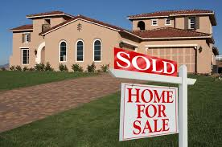
Table of Contents
Introduction
Data Tour
Market Insights
Summary

Slide 3
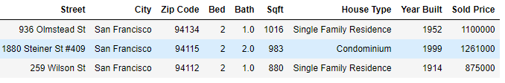
Introduction
With the help of web scraping technique we have extracted the data from MLS Listing and Zillow website.
The collected data are the houses Sold in the past six month only.
There are total 1154 distinct properties.
And, total 8 features per property: City, Zip Code, Bed, Bath, Sqft, House Type, Year Built, Sold Price.

Slide 4
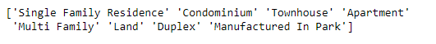
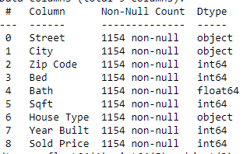
Cities:
House Type:
Data Type of all the features:
The dataset is divided based on the city among the group members.

Slide 5

Data Tour

Slide 6
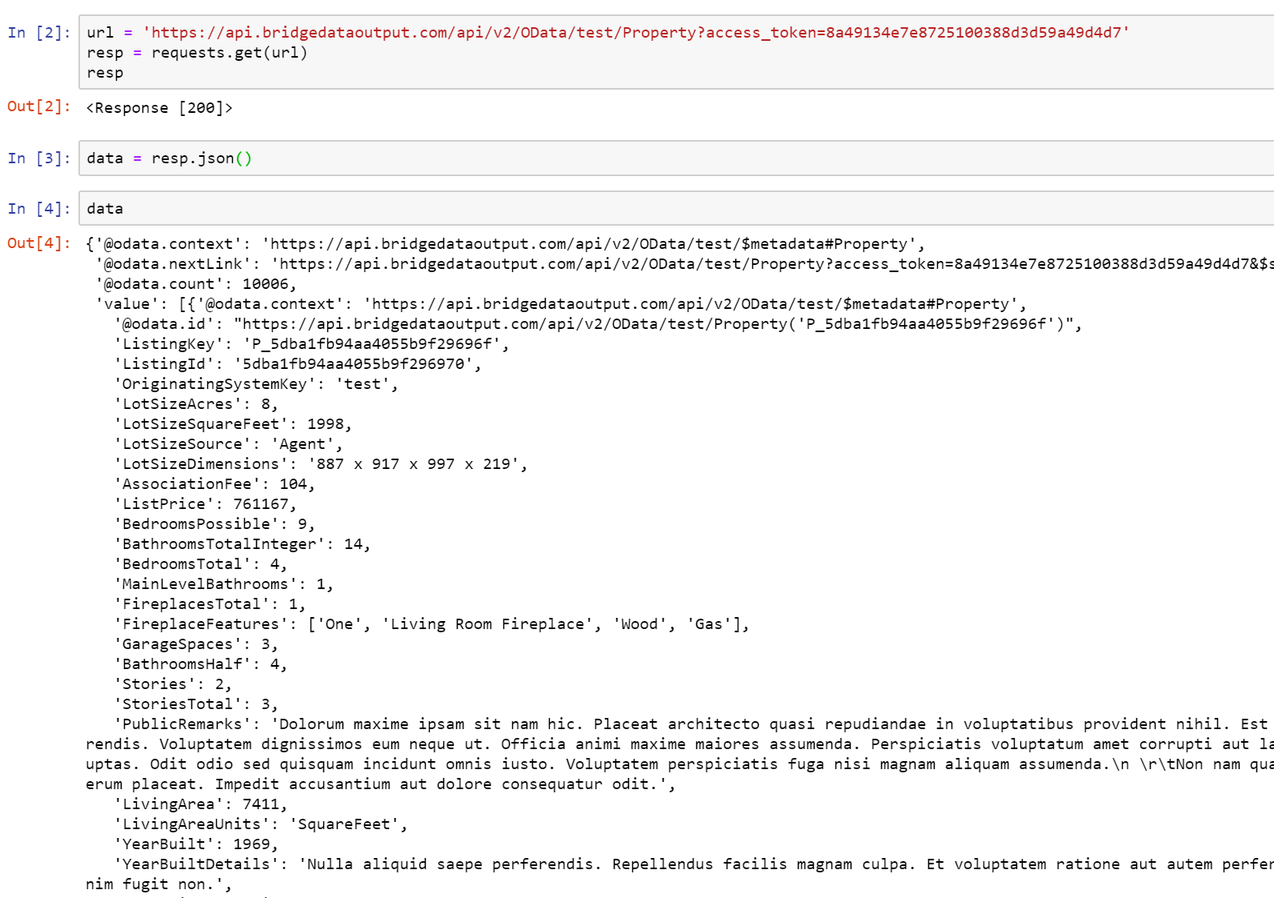
Web Scraping:
Accessing Zillow’s Bridge API.
Ultimately did not end up being used because of the following limitations:
Querying limitations
Lack of information in nested Json()

Slide 7
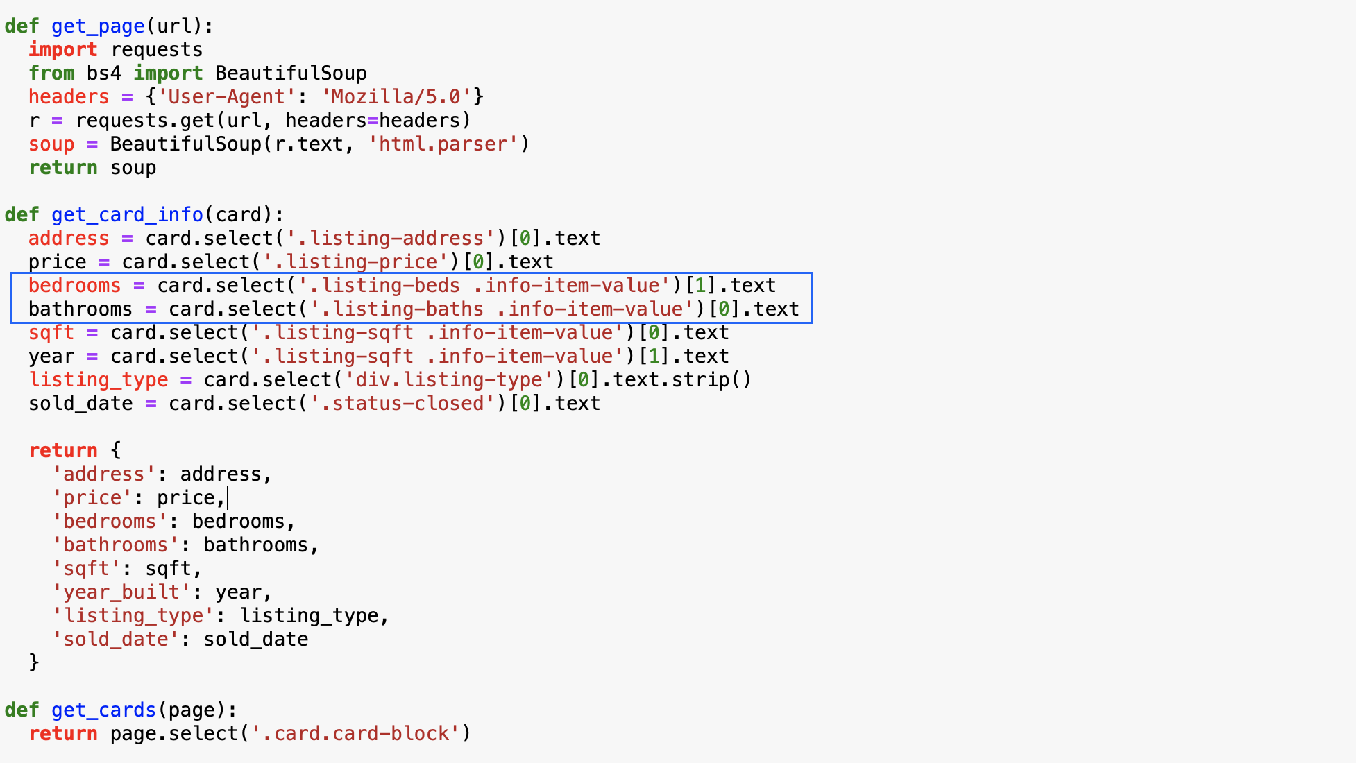
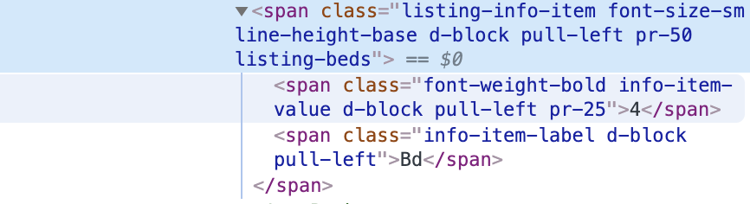
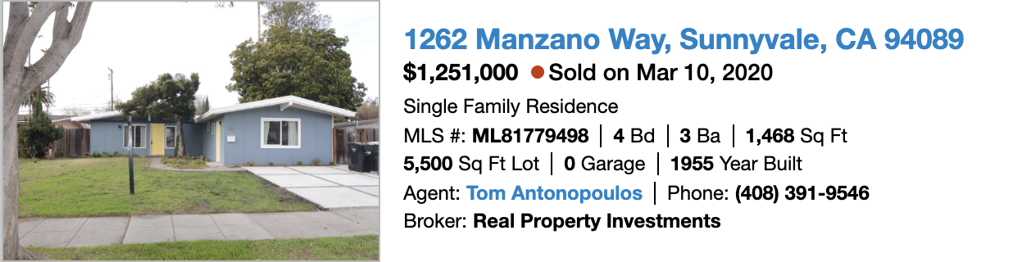
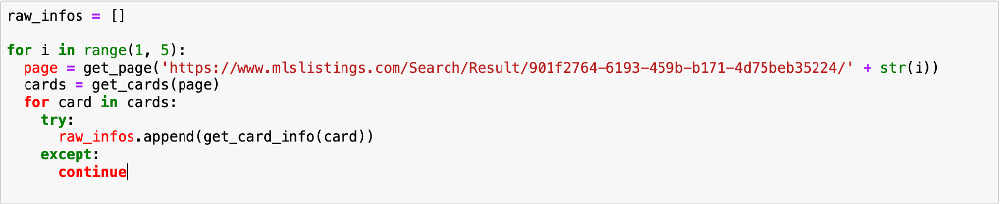
Web Scraping
BeautifulSoup
CSS Selectors

Slide 8
Data Cleaning Techniques
Data Cleaning Process
Define, Code, Test
Data Issues
Data Quality
Issues with the content, low quality data is also known as dirty data.
Eg, missing and duplicates values, some values are far outside a realistic range,
Erroneous data type, wrong measurement units, lowercase mixed with Uppercase
Data Tidiness
Issues with structure that prevent easy analysis, known as messy data
Eg. Naming Convention, two variables in one column,
Assessment
Visual Assessment: eg. excel, text editor.
Programmatic Assessment: eg. df.head(), df.info(), df.describe(), isnull(), duplicated(),

Slide 9
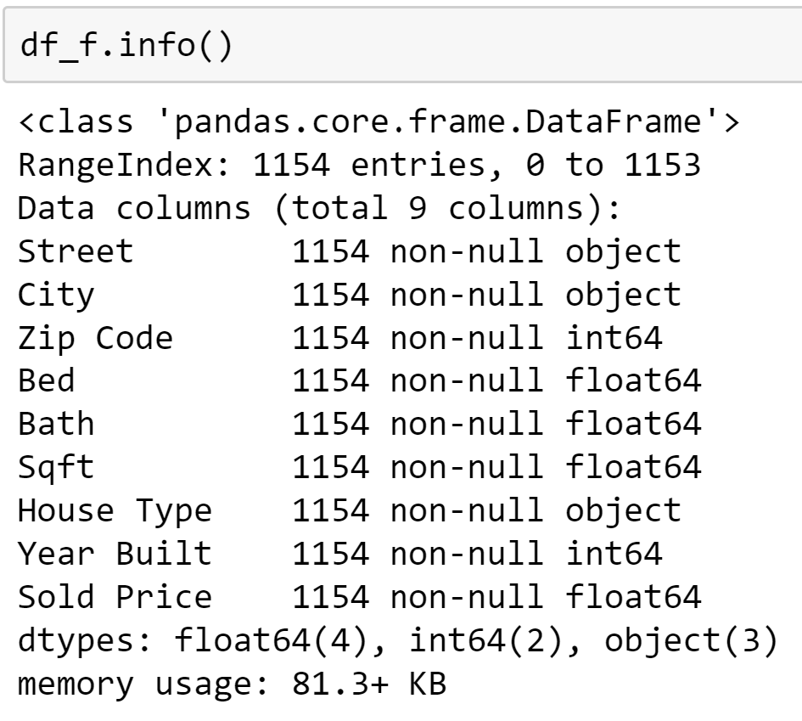
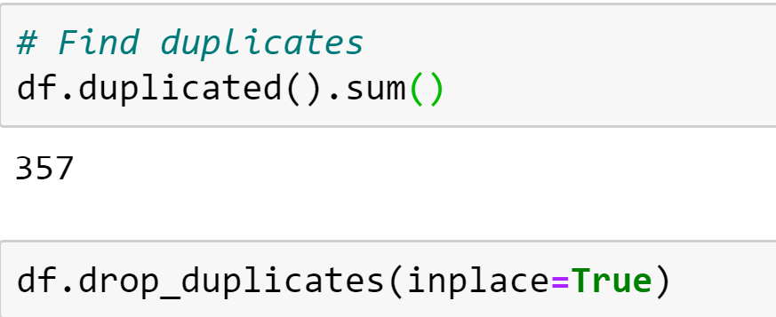
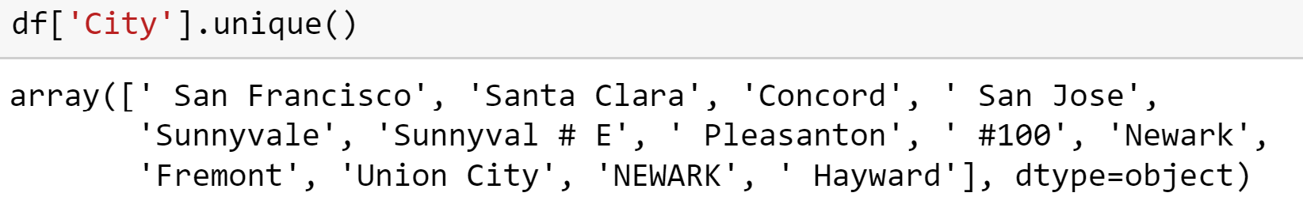
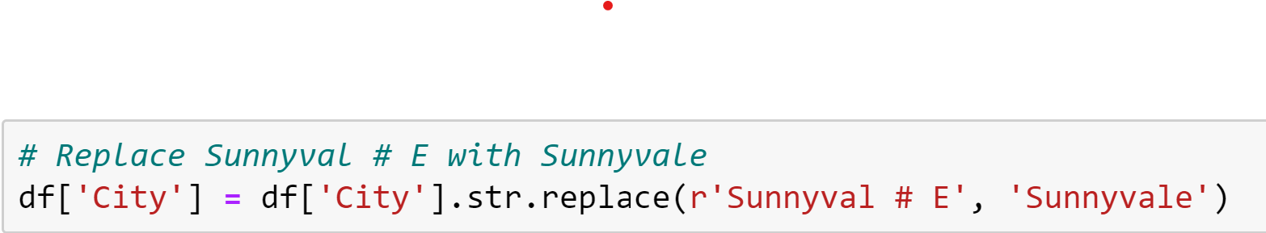
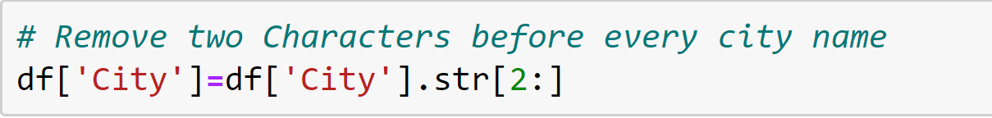
Data Cleaning Techniques
Check & Change Data Type Check & Drop Duplicates
Check & Fix Dirty Data

Slide 10
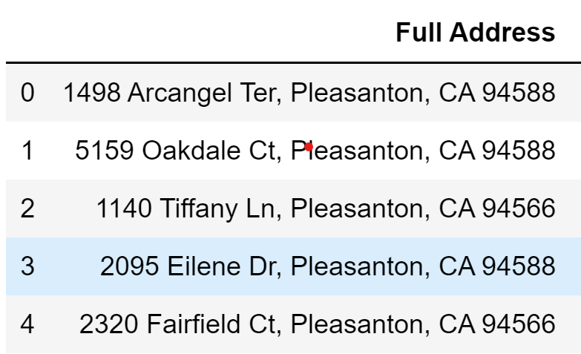
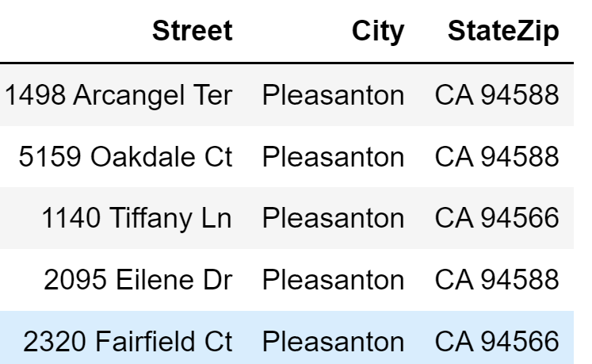
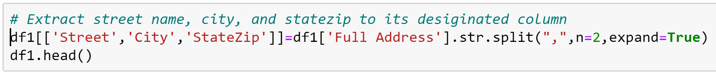
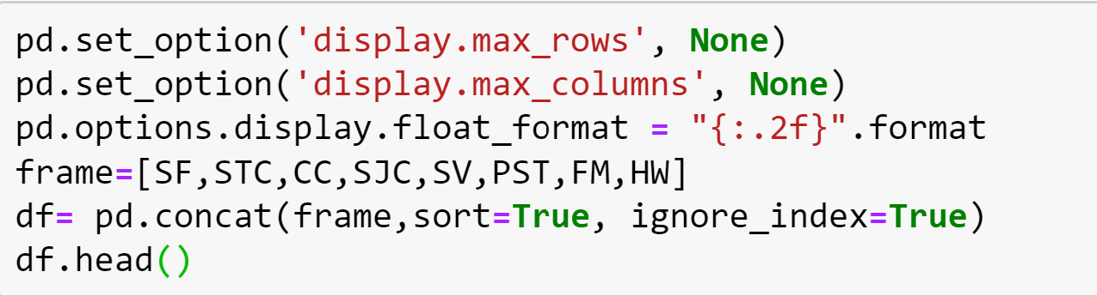
Data Cleaning Techniques
Extract Value to Columns Outcome
Dataset Concatenation & Display Setting

Slide 11
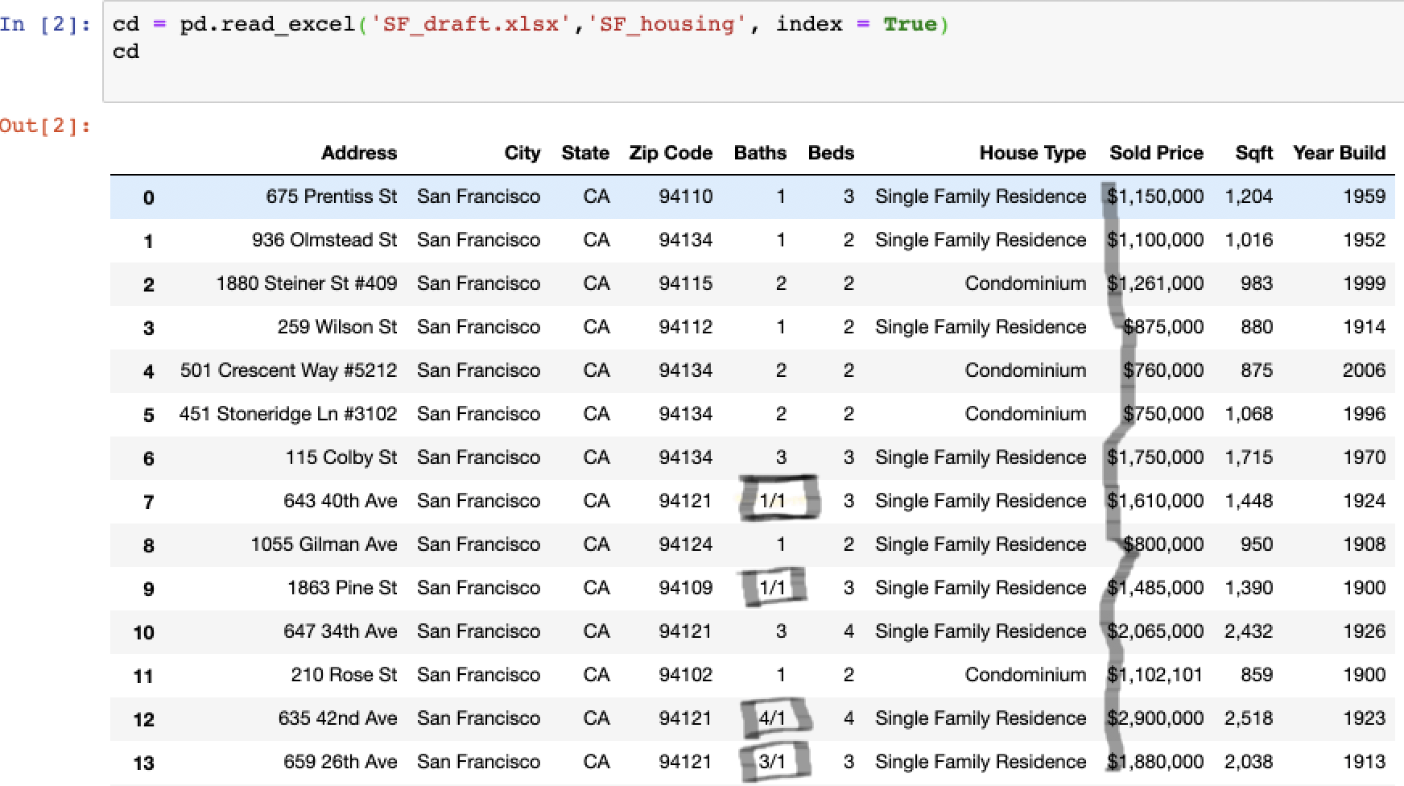
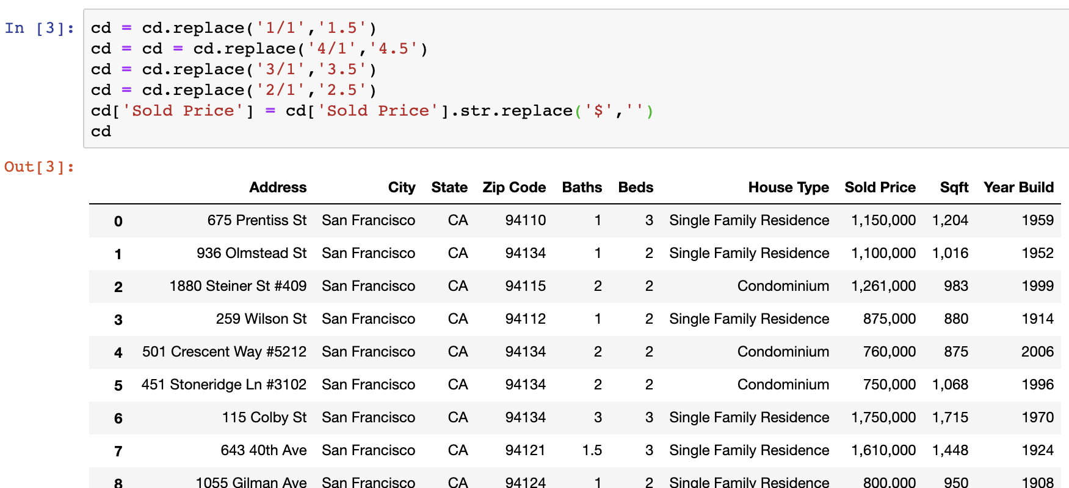
Data Cleaning Techniques
We do not need data like 1/1, 4/1, 3/1, and $ in Baths column and Sold Price
DataFrame.replace() can handle this problem!

Slide 12
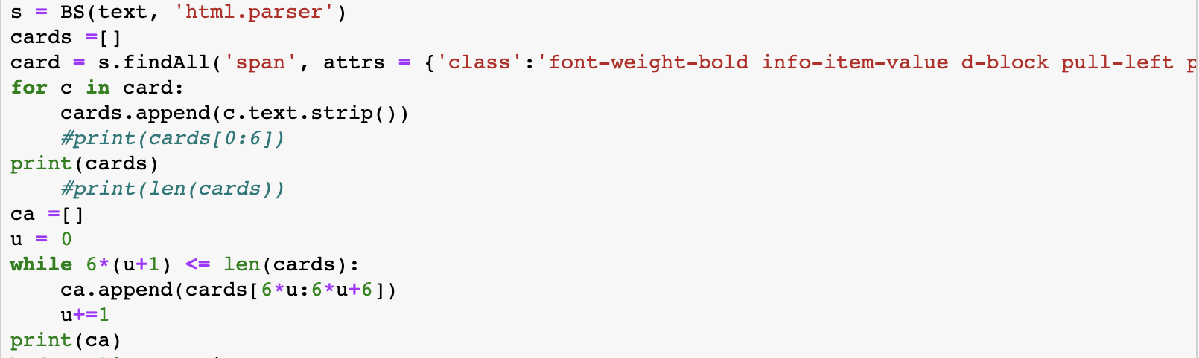
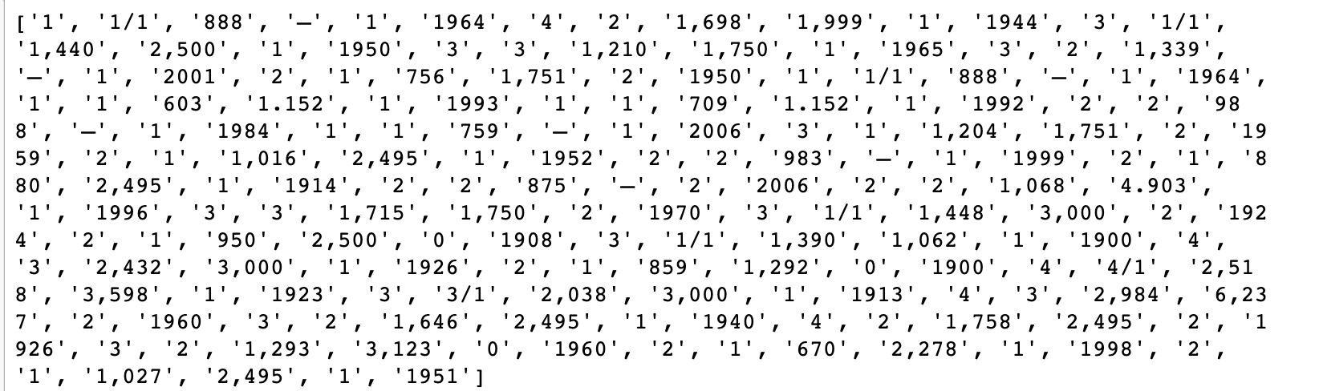
Data Cleaning Techniques
Have you ever had this problem?
The value inside the output list include “Bed room number”, “Bath room number”, “Square Foot”, “Lot size”, “Garage”, and “Year Built”
How to clean data from this multiple data list?

Slide 13
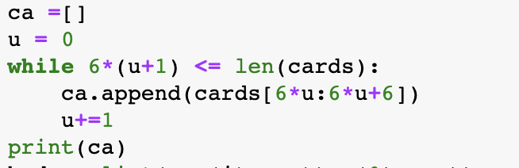
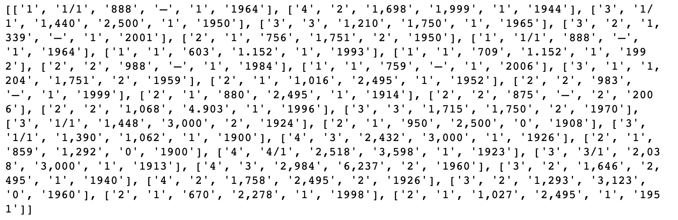
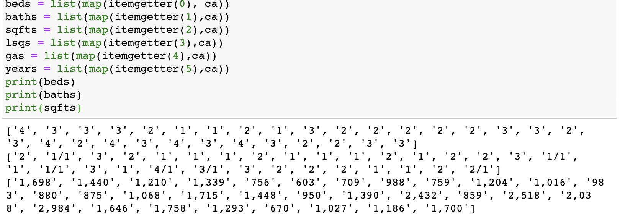
Data Cleaning Techniques
Here is what I did...
In list ca, I just divided the multiple data list to multiple small lists which just contain 6 data in each small list. Such as, we have [“Beds”, “Baths”, “SqFt”, “Lot size”, “Garage”, “Year Build”]as a value for ca.
Conclusion:
Cleaning data during web scraping could be less efficient than cleaning in Data frame

Slide 14
Market Insights

Slide 15
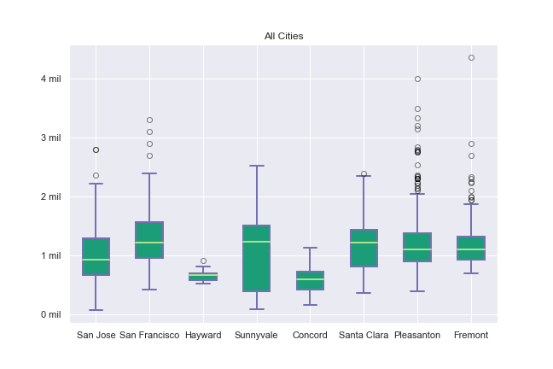
Question: Are visuals enough to predict the housing market?
How do cities compare?
We can see the distribution of houses sold in all cities
Roughly speaking, most houses tend to sell for a million dollars
Outliers in several cities

Slide 16
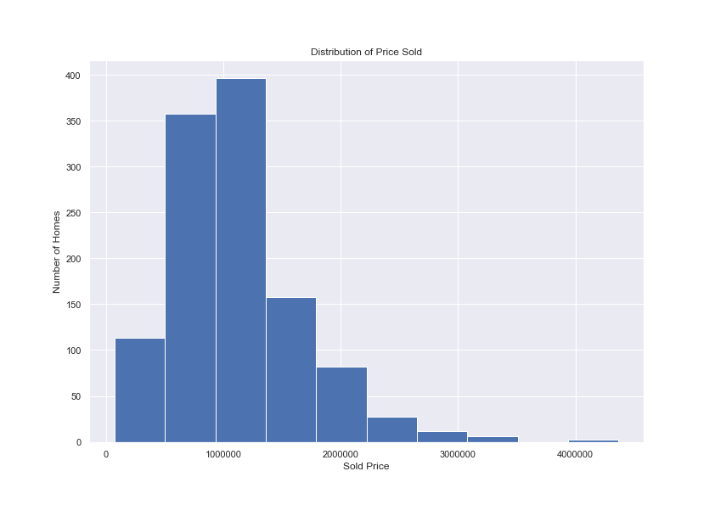
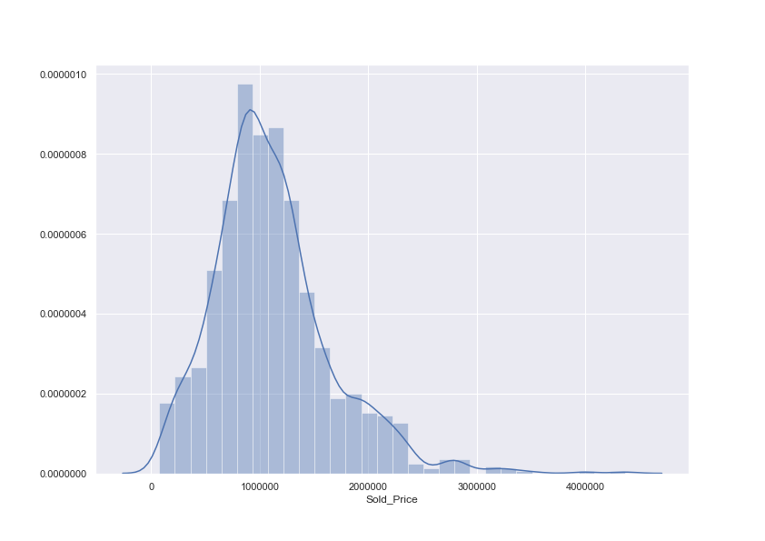
Cities like Pleasanton and Fremont shift the data.

Slide 17
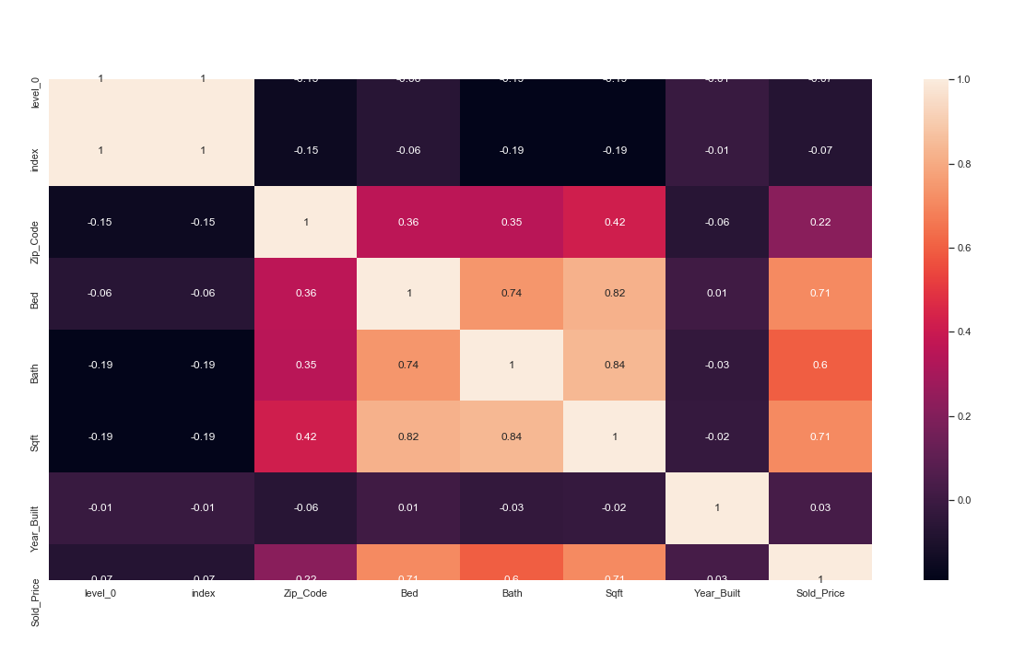
Conclusion:
No, further analysis is needed. A regression model can be used to predict the housing market
We can find attributes that are correlated with sold price and add them as variables for a regression model.
Bedroom and square feet are possible variables that can be used as predictor variable.

Slide 18
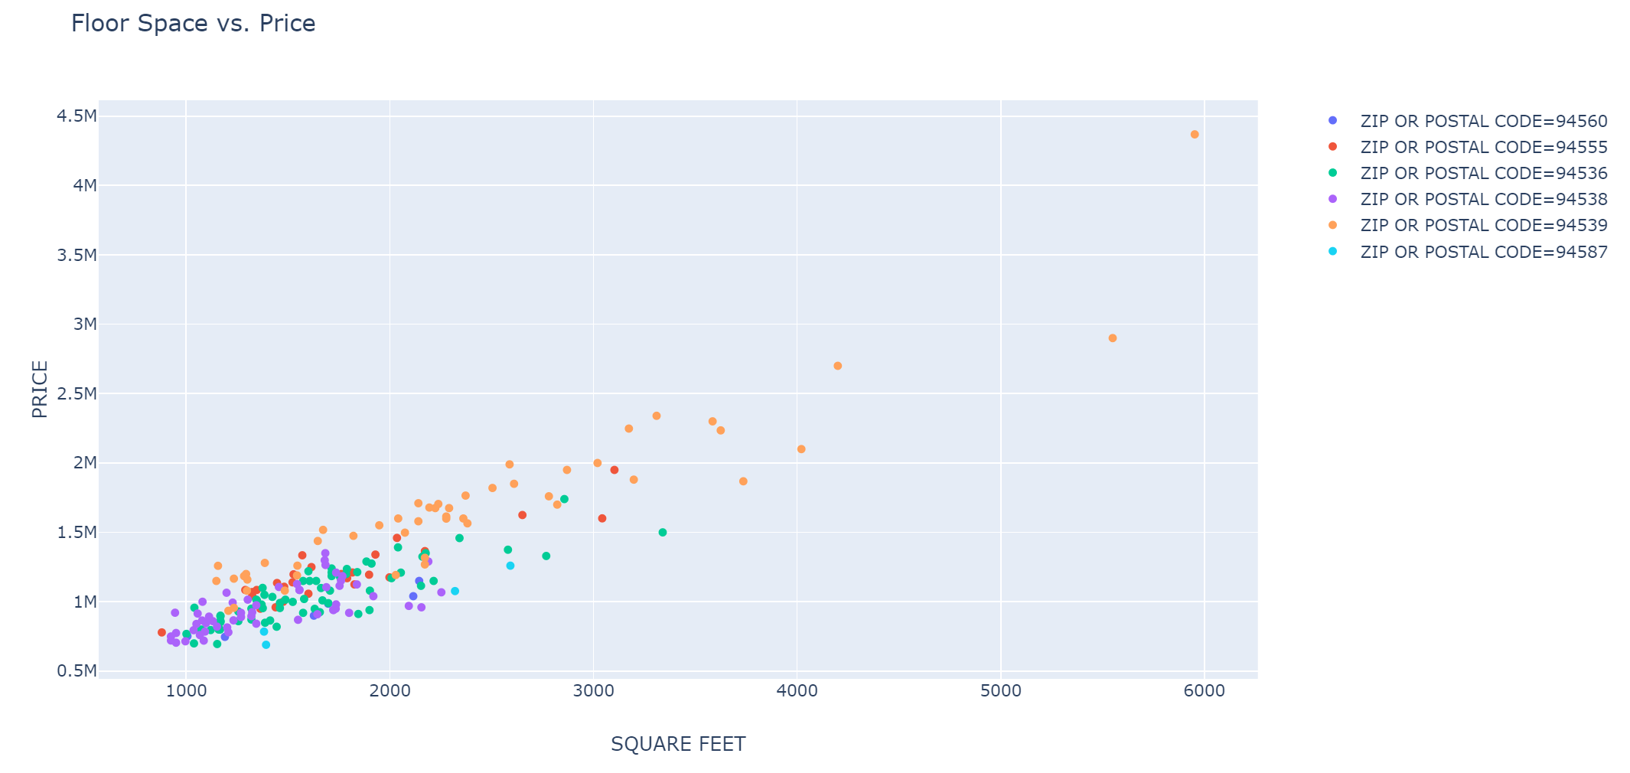
Question: Using Fremont as a sample, can we determine the impact of floor space (sqft) on the price of a home?
Conclusions: Floor space impacts the price of a home but mostly inside a specific location. Prices can vary widely between two locations even in the same city.

Slide 19
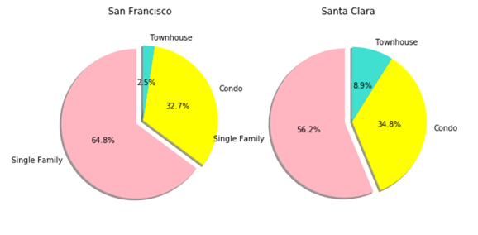
North
(San Francisco)
VS
South
(Santa Clara)
What are their commons and differences between San Francisco and Santa Clara?
▪1. Single family house has the largest portion
▪2. Condo
▪3. Townhouse
Notes:
Common: Single Family house largest portion and Condos has also the equal proportion.
Difference: Townhouse proportion is more in Santa Clara compared to San Francisco

Slide 20
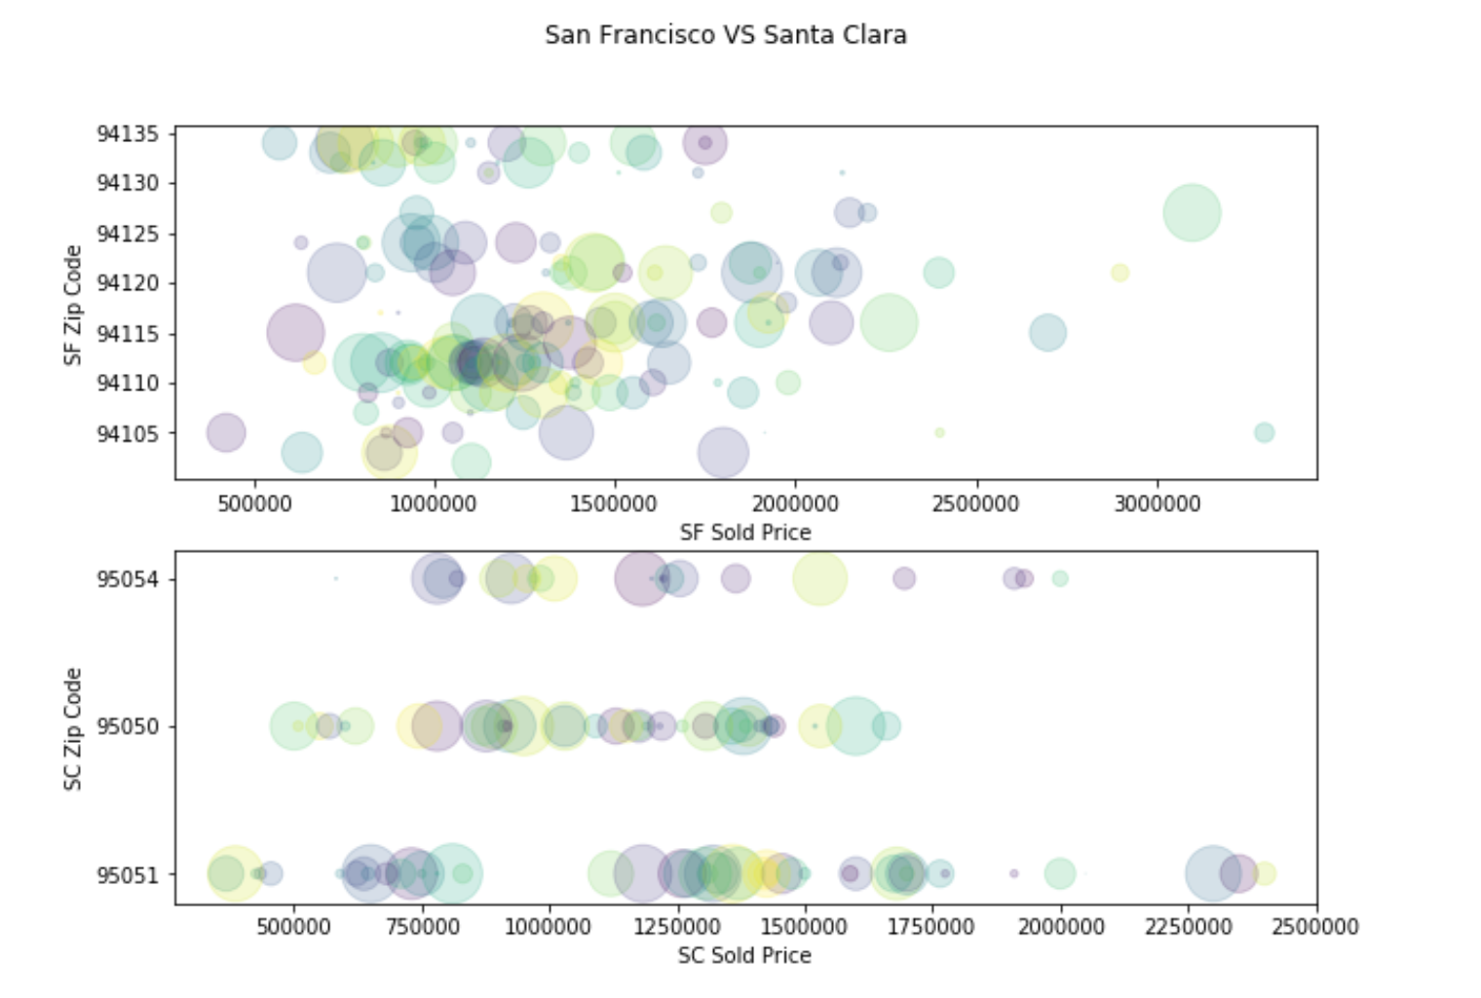
North
(San Francisco)
v.s
South
(Santa Clara)
▪San Francisco(decentralize) vs Santa Clara(centralize)
▪Range of regular price: 450K to 2m.
▪San Francisco highest price vs Santa Clara highest price
-(3b3b condo $3.3m VS 4b2b family house $2.4m)
▪San Francisco lowest price vs Santa Clara lowest price
-(2b2b condo $400K VS 1b1b condo $370K)

Slide 21
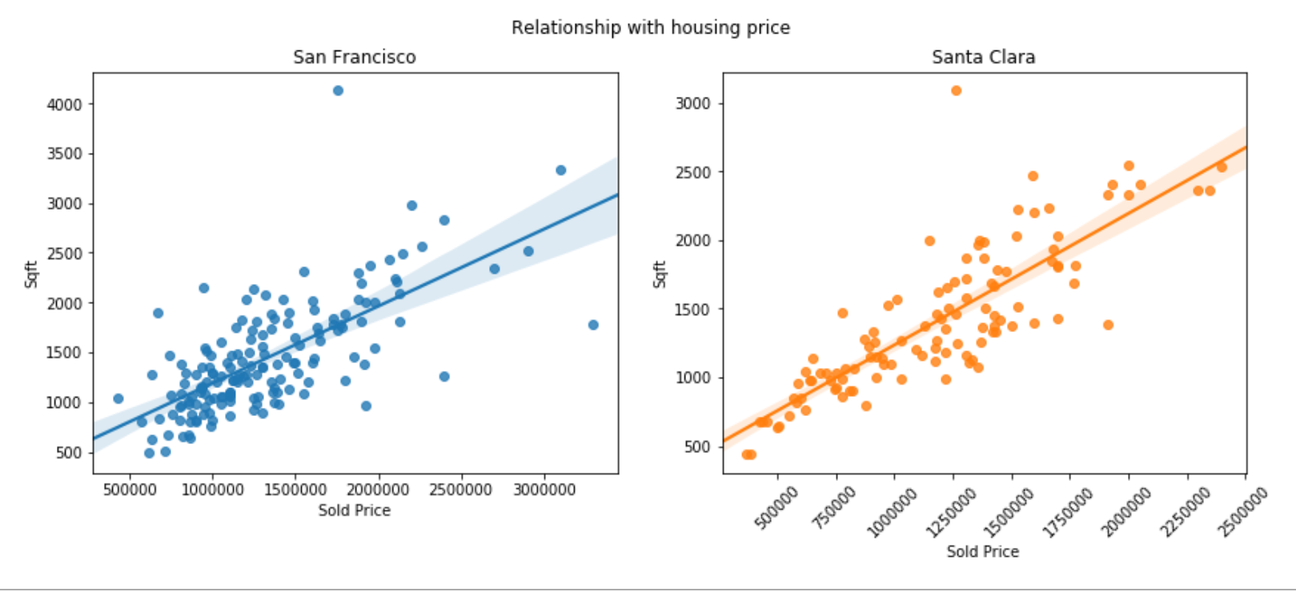
North
(San Francisco)
VS
South
(Santa Clara)
Conclusion:
▪Both the median house cost is about 1 million.
▪They almost have the same range of costs between the lowest and highest prices.
▪Price is affected by house size.
▪San Francisco's housing price is mostly affected by the view rather than the size.

Slide 22
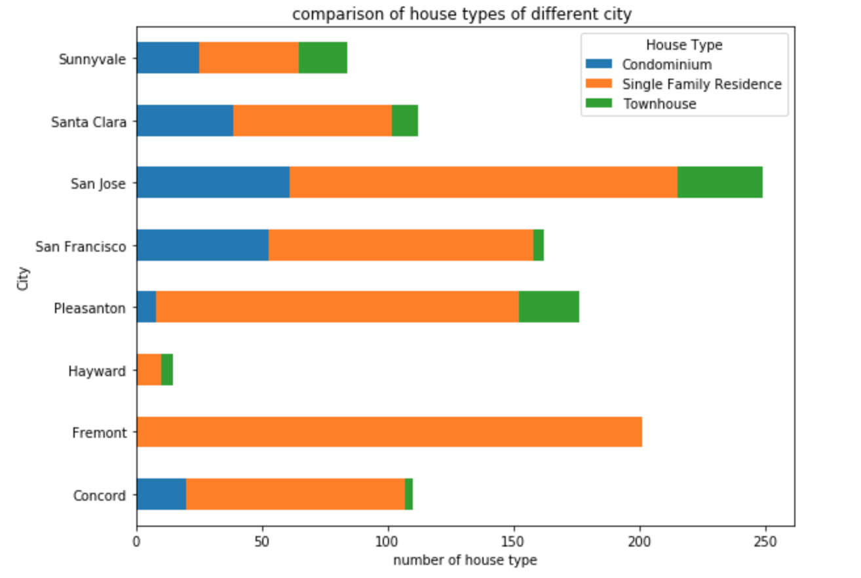
If house types’ distributions are really different from each other among our interested cities.
An overview of house data set scale in each city
Single family is the most common house type
No condominium and townhouse in Fremont of our data set
How can house types give us some information about the house sold price in Bay Area?

Slide 23
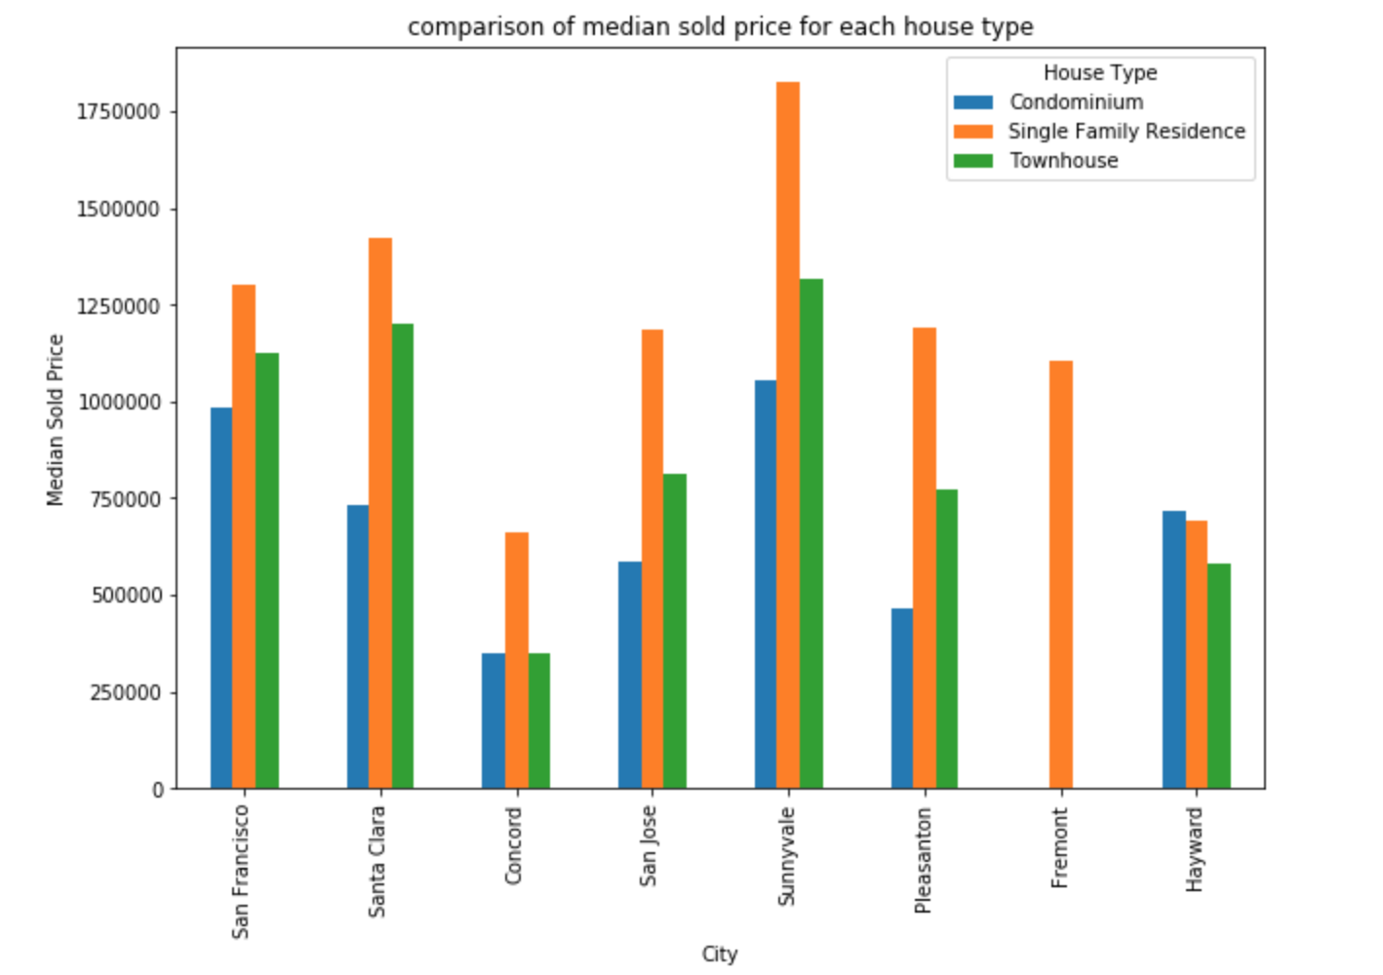
How about each cities’s specific house types and there median sold price?
San francisco, Santa Clara and Sunnyvale seem to have higher sold price, on the other hand, Concord and Hayward have lower sold price.
Single family house type which represented by the orange color is more expensive than other house types and the condominium’s sold price is the lowest of three house types.
Special thanks to all the people who made and released these awesome resources for free.
Presentation template by SlidesCarnival
Photographs by Unsplash
Learn more about slidedocs at duarte.com/slidedocs

Slide 24

Summary
Single family residence accounts for the largest proportion of house types in Bay Area and roughly has higher median sold price.
Square feet is one of the best feature to predict the Sold Price.
San Francisco bay view homes has an impact on the sold price.

Slide 25
Thank You

